Slide 1

Marketing
& Growth
Strategy
Srijan Mishra

Slide 2
Table of Contents
01
02
03
04
05
06
User Base & TG
Growth Strategy
Ad Pitch
Current user-base and target audience
Things to implement in order to increase growth
Concept ads to maximize app downloads
App Improvements
Additional Tips
End
A few changes and optimisations
A few additional ideas, points & improvements
End of presentation

Slide 3

User Base
& Target Audience
01

Slide 4
User Base
Target Audience
Demographics: Primarily Hindi-speaking users in India, with a focus on Tier 2 and Tier 3 cities. Age range could be 25-60+ with a skew towards millennials (25-40).
Interests: News consumption, local news, regional updates, entertainment, astrology, devotional content, cricket updates, financial news, and local business listings.
Tech Savvy: Moderately tech-savvy users comfortable with basic app functionality and content consumption.
Primary: Hindi-speaking individuals in Tier 2 and Tier 3 cities who rely on mobile for news consumption and prefer regional updates.
Secondary: Young professionals from smaller towns migrating to bigger cities who still seek local news and community connections.

Slide 5

Growth Strategy
02

Slide 6
Play Store & App Store Growth
Targeted App Store Optimization (ASO): Optimizing app title, description, and keywords for relevant searches. Refine app descriptions on the Play Store with relevant keywords and a concise yet compelling narrative. Highlight unique features that set Dainik Bhaskar Legacy apart.
Referral Programs: Incentivize existing users to refer friends and family through rewards or discounts.
Visual Appeal: Upgrade the Play Store visuals with screenshots that showcase the app's interface, diverse news categories, and user-friendly design. Visuals should instantly convey the app's value.
Frequent Updates: Regularly update the app's page on the Play Store, not just with bug fixes but also with exciting new features or exclusive content announcements. This keeps the app fresh and encourages users to stay engaged.
ORM: Responding to user comments and messages promptly to build a community around the app. Optimize the Play Store listing with relevant keywords and high-quality screenshots.
SEM: Running targeted ad campaigns on social media and search engines to reach a wider audience.
By implementing these things, we can effectively improve the App Store and Play Store presence, resulting in increased downloads and engagement for Dainik Bhaskar.

Slide 7
Social Presence & Growth
Engagement Campaigns: Launching interactive campaigns on social media, encouraging users to share their favorite news stories with a dedicated hashtag. This fosters community engagement and widens the app's reach.
Live Q&A Sessions: Hosting live Q&A sessions with Dainik Bhaskar Leaders or industry experts. This not only humanizes the brand but also positions the app as a platform for meaningful discussions.
User Spotlight: Regularly featuring user testimonials and stories on your social media platforms. This adds authenticity and encourages others to join the Dainik Bhaskar community. Content Marketing: Creating engaging and shareable content on social media platforms like Facebook, WhatsApp, and Instagram targeted towards the audience's interests.
Collaborations: Partnering with regional influencers, celebrities, or local businesses for app promotion.

Slide 8
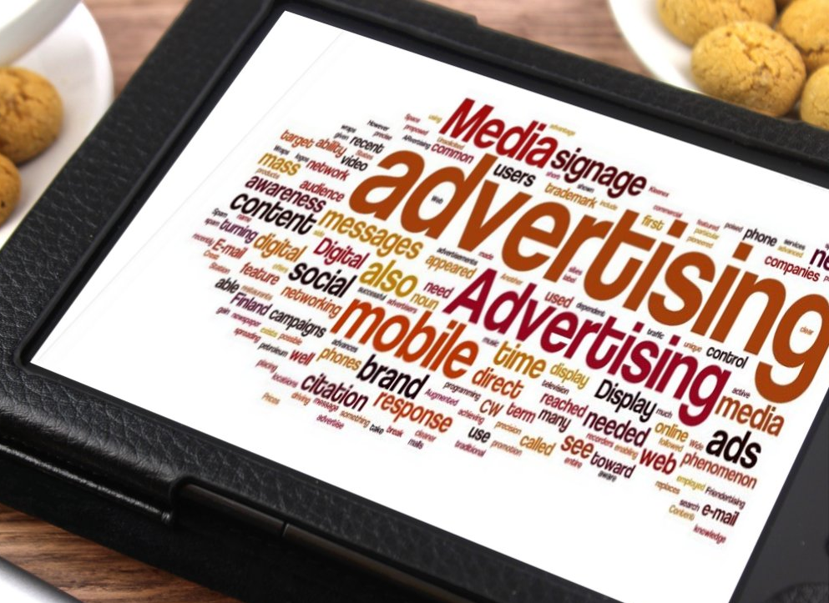
Concept
Ad Pitch
03

Slide 9

Creative Ad 1
Lok Ka Hero (Local Hero)
Headline: अपना शहर, अपनी कहानियां. दैनिक भास्कर ऐप के साथ, जिएं अपने आस-पास की धड़कन! (Get your city's news and stories close at hand, only on the Dainik Bhaskar App!)
Description: आपके मोहल्ले की किराना दुकान से लेकर आपके बच्चे के स्कूल तक, Dainik Bhaskar के हाइपर-लोकल न्यूज़ से अपने आसपास की हर खबर पर रहें अपडेट। ऐप डाउनलोड करें और खुद एक लोकल हीरो बनें, अपनी कहानियां शेयर करें और अपने समुदाय से जुड़ें। (Stay updated on everything happening around you, from your local grocery shop to your child's school, with Dainik Bhaskar's hyper-local news. Download the app and become a local hero yourself, sharing your stories and connecting with your community.)
Just for Reference
Video: Open with a montage of everyday heroes in your local community - shopkeepers, teachers, farmers, activists. Each holding a phone with the Dainik Bhaskar app open, showing relevant news stories about their area.

Slide 10
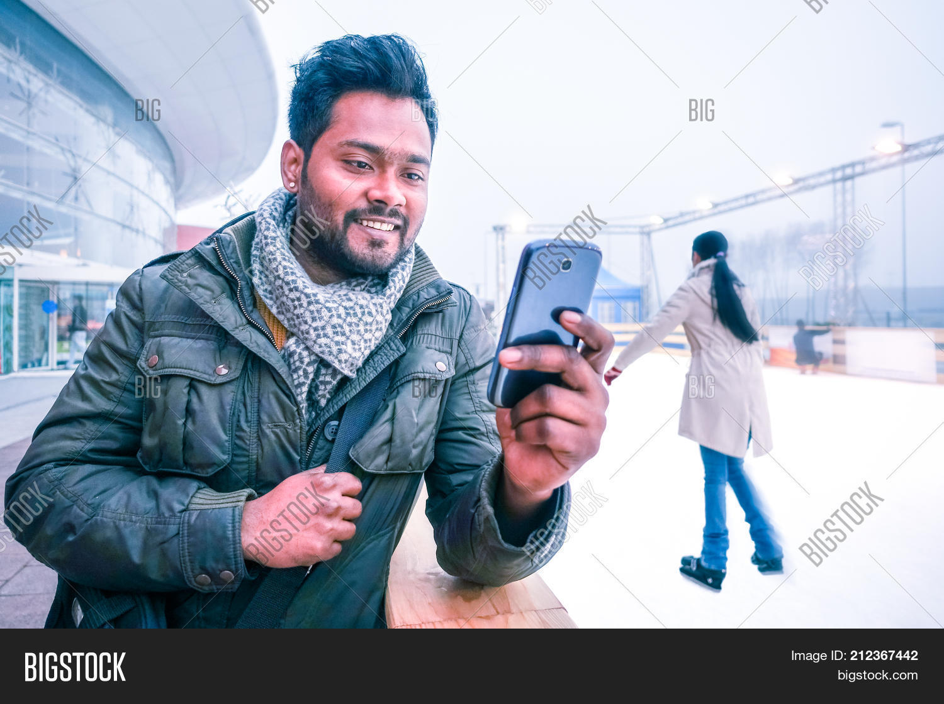
Creative Ad 2
Niklo Ghar Se Befikar (Know Before You Go)
Headline: दिन का प्लान बिल्कुल सही - ट्रैफिक, मौसम, खाना, मस्ती, सबकुछ Dainik Bhaskar App पर! (Plan your day perfectly - traffic, weather, food, fun, it's all on the Dainik Bhaskar App!)
Description: ट्रैफिक में न फंसें, आज रात के लिए परफेक्ट रेस्टोरेंट ढूंढें, या अपने शहर के छिपे हुए रत्नों को खोजें। Dainik Bhaskar आपको घर से निकलने से पहले ही हर जरूरी जानकारी से अपडेट रखता है। ऐप डाउनलोड करें और हर दिन को एक एडवेंचर बनाएं। (Don't get stuck in traffic, find the perfect restaurant for tonight, or discover hidden gems in your city. Dainik Bhaskar keeps you informed about everything you need to know before you even step out the door. Download the app and make every day an adventure.)
Just for Reference
Image: A split screen showing a person relaxing at home with their phone on one side and a vibrant city scene on the other, highlighting the app's usefulness for planning outings

Slide 11

Creative Ad 3
Itihaas Se Vartman, Sab Aapke Jeb Mein (History in Your Pocket):
Headline: अतीत से वर्तमान तक, Dainik Bhaskar App के साथ इतिहास को देखें! (Witness history unfold, from past to present, with the Dainik Bhaskar App!)
Description: अपने शहर के समृद्ध इतिहास को उजागर करें, भूली हुई कहानियों का पता लगाएं और अपने फोन से ही प्रतिष्ठित पलों को फिर से जीएं। Dainik Bhaskar का व्यापक संग्रह अतीत को जीवंत बनाता है। ऐप डाउनलोड करें और अपने शहर की विरासत से जुड़ें। (Uncover the rich history of your city, explore forgotten stories, and relive iconic moments right from your phone. Dainik Bhaskar's comprehensive archives bring the past to life. Download the app and connect with your city's heritage.)
Just for Reference
Image: Split screen with an iconic historical photo from your city on one side and the Dainik Bhaskar app displaying an article about the same event on the other

Slide 12
Impact & Why
Ad Creative 1 Taps into emotional connection: People care about their local communities and heroes. Seeing familiar faces and relatable stories makes the app feel personal and relevant.
Highlights hyper-local focus: This is Dainik Bhaskar's strength. Showcasing it positions the app as the go-to source for local news and events.
Encourages user engagement: Mentions sharing stories and connecting with the community, suggesting the app is more than just a news reader.
Ad Creative 2 Appeals to practical needs: People want information that helps them navigate their day-to-day lives. This ad positions Dainik Bhaskar as a handy tool for busy individuals.
Showcases diverse content: Highlights the app's range of services, from traffic updates to entertainment options.
Creates a sense of discovery: Mentions "hidden gems," suggesting the app can help users find new and exciting things in their city.
Ad Creative 3
Leverages Dainik Bhaskar's legacy: Appeals to people's sense of local pride and history.
Offers unique content: Showcases the app's historical archive as a differentiator.
Appeals to curiosity and learning: Encourages exploration and discovery of the city's past.

Slide 13
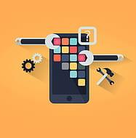
App Improvements
04

Slide 14
App Improvement Tips
Personalization: Implementing algorithms to recommend news and content based on user preferences and location.
Offline reading: Allowing users to download content for offline access.
Interactive features: Integrating quizzes, polls, or discussion forums to increase engagement.
Multilingual support: Considering to add English and other regional languages spoken in target areas.
Push notifications: Utilizing targeted push notifications for breaking news or personalized updates.
Performance optimization: Ensuring fast loading times and smooth app navigation.
User feedback: Conducting regular surveys and utilize user feedback to improve features and content.
Research: Analyze competitor apps to identify their strengths and weaknesses, and leverage those insights to differentiate the app.

Slide 15
Additional
Tips
05

Slide 16
App Improvement Tips
App Store Presence: Negative user reviews and unaddressed complaints on the App Store can significantly deter potential downloads. Prioritize responding to feedback and implementing improvements based on user input.
Accessibility: Expanding language options to include English would broaden the app's reach and cater to a younger and next-gen audience.
Visual Optimization: Evaluate the current font styles and sizes, ensuring they are legible and aesthetically pleasing across different devices.
Reels Engagement: Utilize the Reels section within the app by creating engaging video content with proper captioning to leverage the platform's reach and attract new users.
Navigation Simplification: The current navigation bar might be overwhelming with too many options. Streamlining the menu and optimizing button placement can improve user experience and intuitive navigation.
Sharing Functionality: Reassess the placement and frequency of the share option throughout the app. Strategic placement on relevant pages can encourage sharing without feeling intrusive.

Slide 17
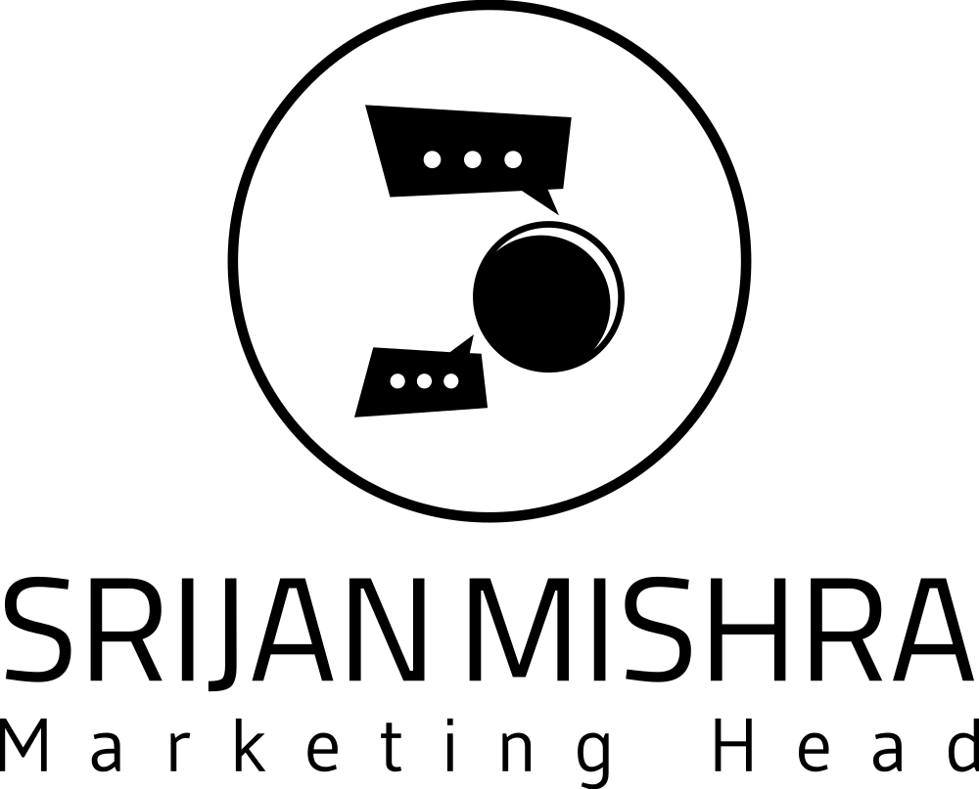
Thank You
Do you have any questions?
srijan.web3@gmail.com | +919179585554|

